Slide 1
Chapter 3 SQL Operations on Multiple Tables

Slide 2
Joining Tables
3.1
We are going to learn how to summarise data from multiple tables in this chapter.

Slide 3
3.1
Finish Activity 3.1 on P. 104 of your textbook.
Case 1: 4
Case 2: We cannot. As SID is the primary key and thus it cannot be NULL.
Case 3. We cannot. As the data is lost after the deletion.

Slide 4
3.1
Case 1: 1
Case 2: In table CLUB.
Case 3: In table CLUB.

Slide 5
3.1
Which of the above is the better practice? Why?
The latter. It requires fewer updates, allows data to be inserted without dependency and does not lose data due to the deletion of related data.
Assume that each student is allowed to join more than one club. Should we store data as below if Clem joins three clubs at the same time? Why?
No. If the data of Clem needs update, we will have to update three records.
What is the advantage of using this new structure over the previous one?
A student may join as many clubs as they want without adding duplicated data to STUDENT.

Slide 6
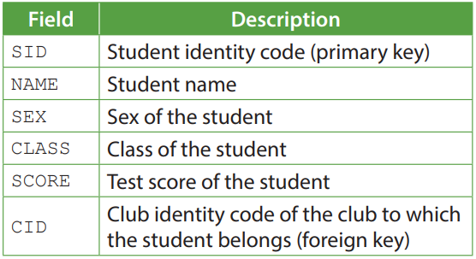
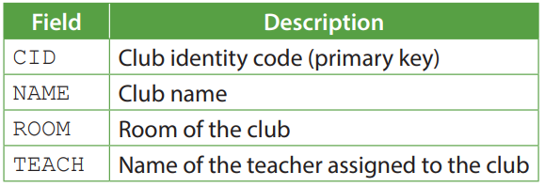
Joining Tables
3.1
Storing data in multiple tables linked with foreign keys allows us to maintain data consistency easier and save data storage.
Take these two tables as an example.

Slide 7
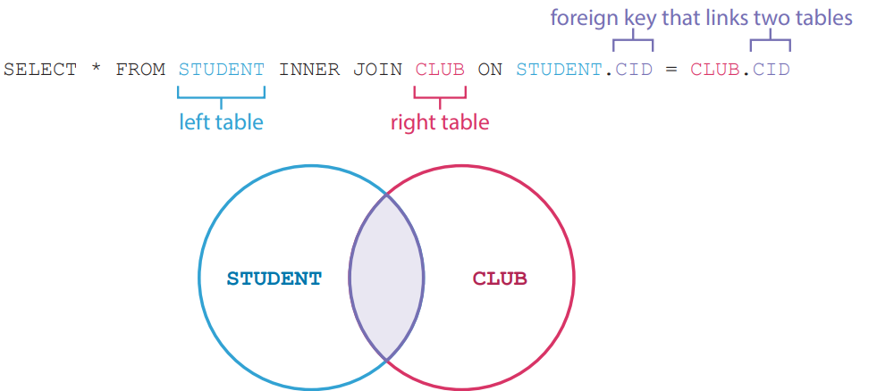
INNER JOIN
A
The result of INNER JOIN includes only the records with matching values in both tables. It can be simplified as JOIN.

Slide 8
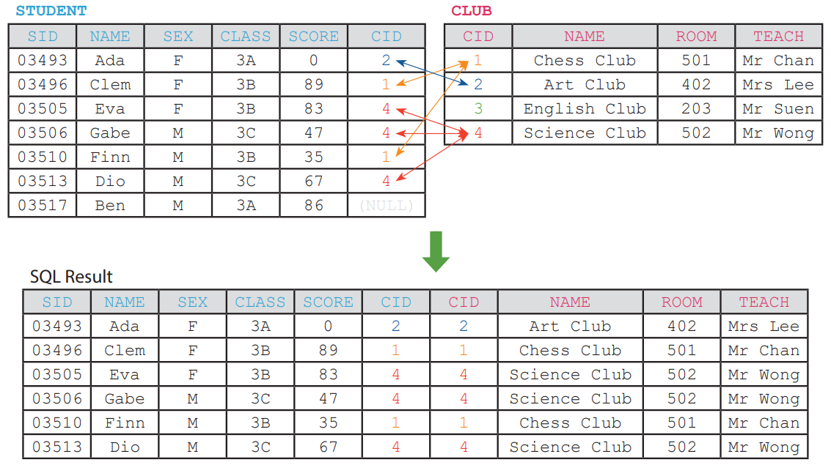
INNER JOIN
A

Slide 9
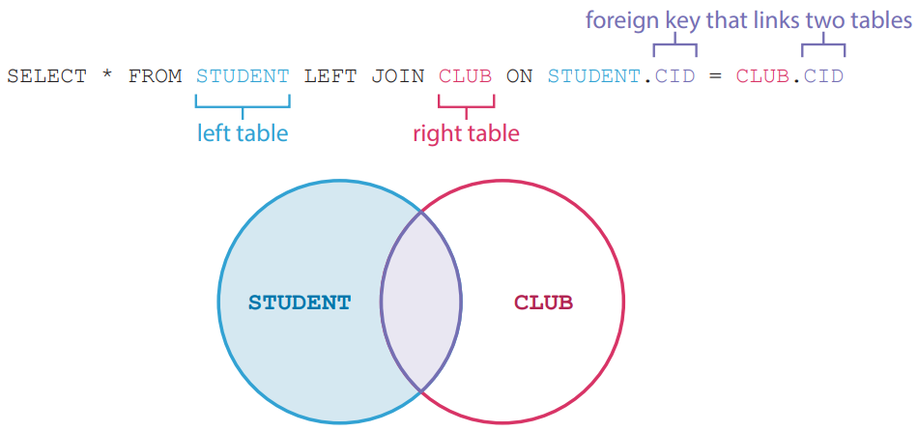
LEFT JOIN
B
The result of LEFT JOIN includes all records in the left table and the records with matching values in both tables. It can be written as LEFT OUTER JOIN.
To know each student belongs to which club, we may use the following SQL statement.

Slide 10
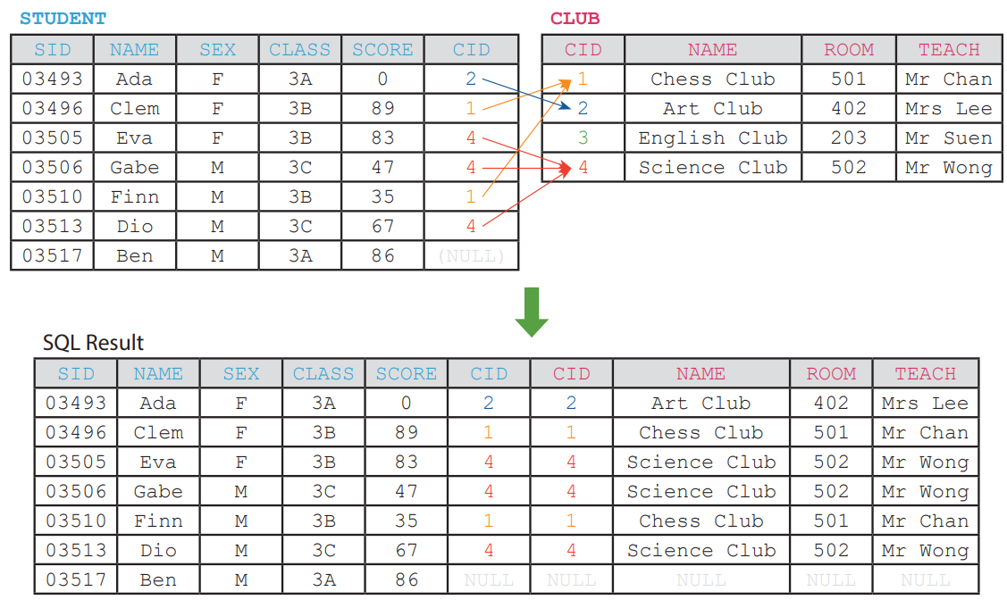
LEFT JOIN
B

Slide 11
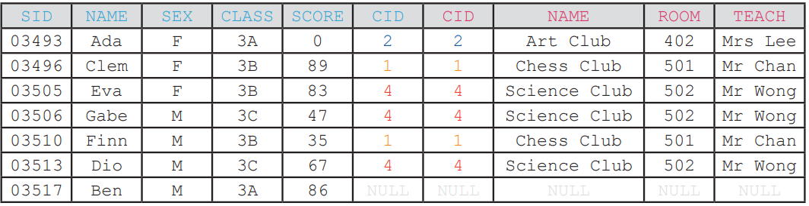
LEFT JOIN
B
Though the student Ben does not belong to any club, his record is still included in the result as STUDENT is the left table and we are using LEFT JOIN.

Slide 12
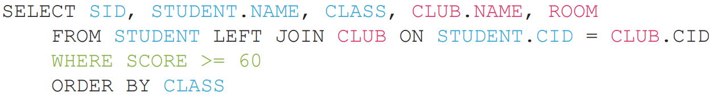
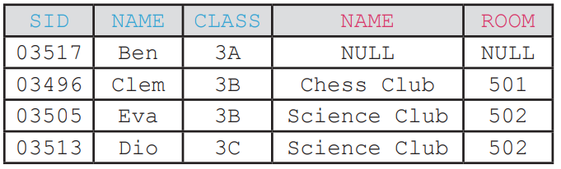
LEFT JOIN
B
The following SQL statement lists the student identity code, the student name, class, the club name and the club room of every student who gets at least 60 scores.

Slide 13
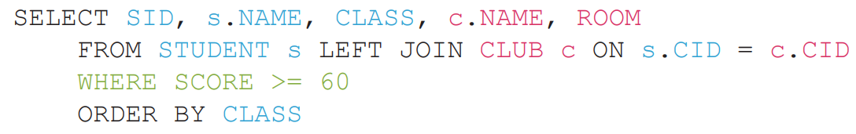
LEFT JOIN
B
We may shorten the SQL statement by giving each table an alias.
The alias s and c refer to the table STUDENT and CLUB respectively.

Slide 14
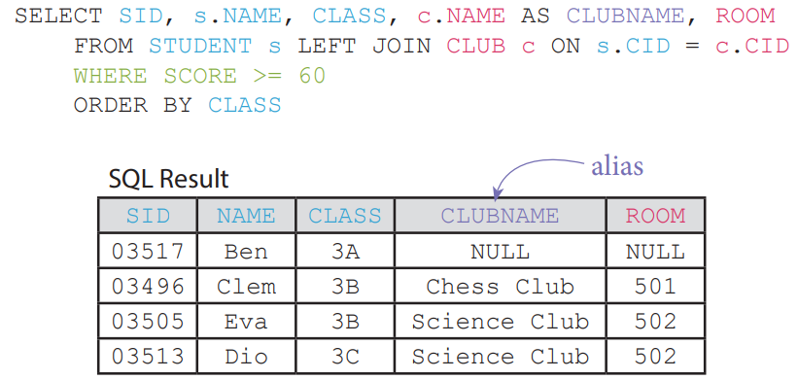
LEFT JOIN
B
To avoid confusion, fields that share the same name may also be renamed by using aliases.

Slide 15
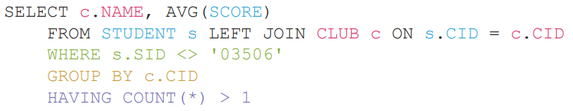
LEFT JOIN
B
We may summarise data obtained by joining tables too.
The following SQL statement lists the club names and the average scores of the students in each club. The student whose student identity code is 03506 is excluded. Only clubs with more than 1 student are listed.

Slide 16
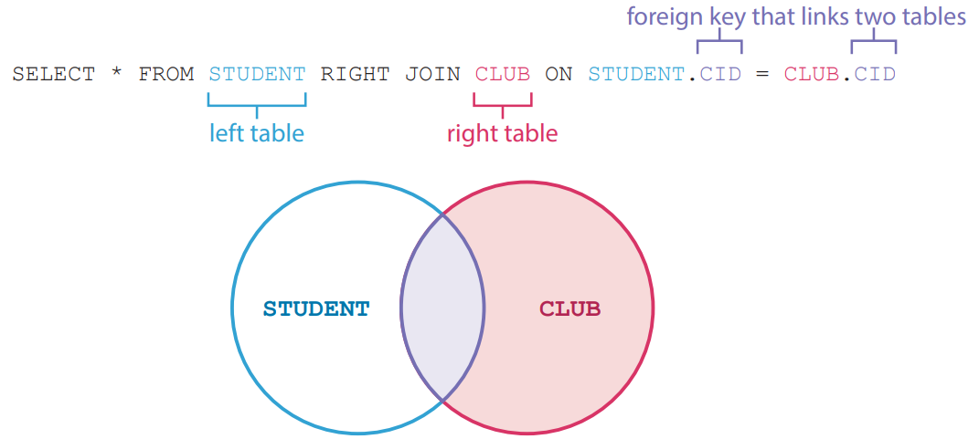
RIGHT JOIN
C
The result of RIGHT JOIN includes all records in the right table and the records with matching values in both tables. It can be written as RIGHT OUTER JOIN.

Slide 17
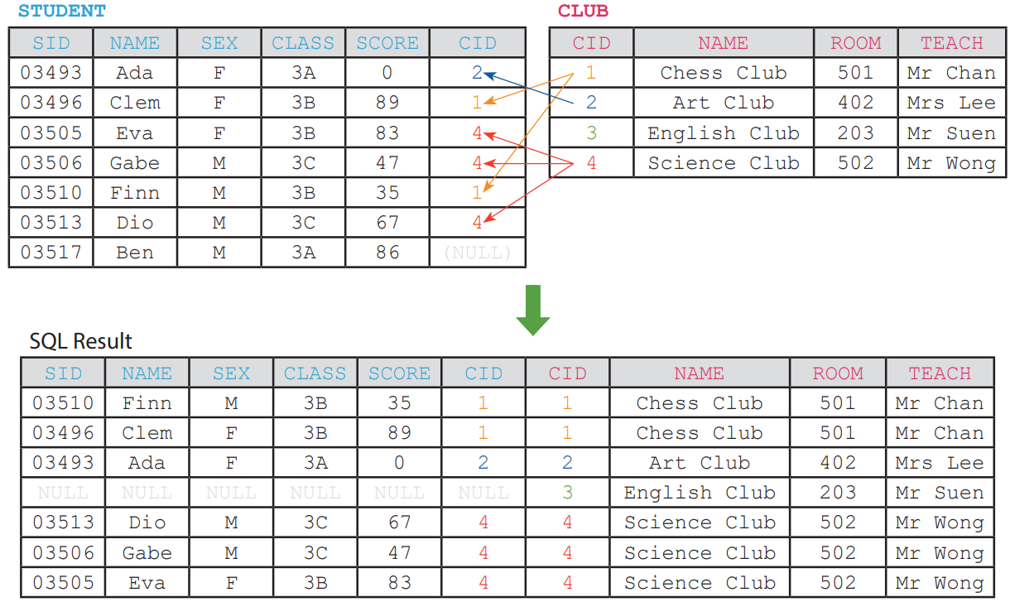
RIGHT JOIN
C

Slide 18
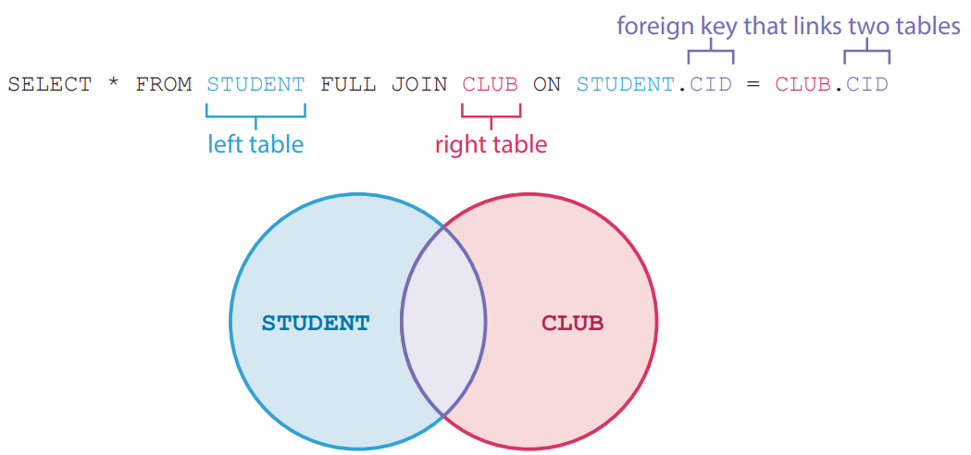
FULL JOIN
D
The result of FULL JOIN includes records from both the left table and the right table. It can be written as FULL OUTER JOIN.

Slide 19
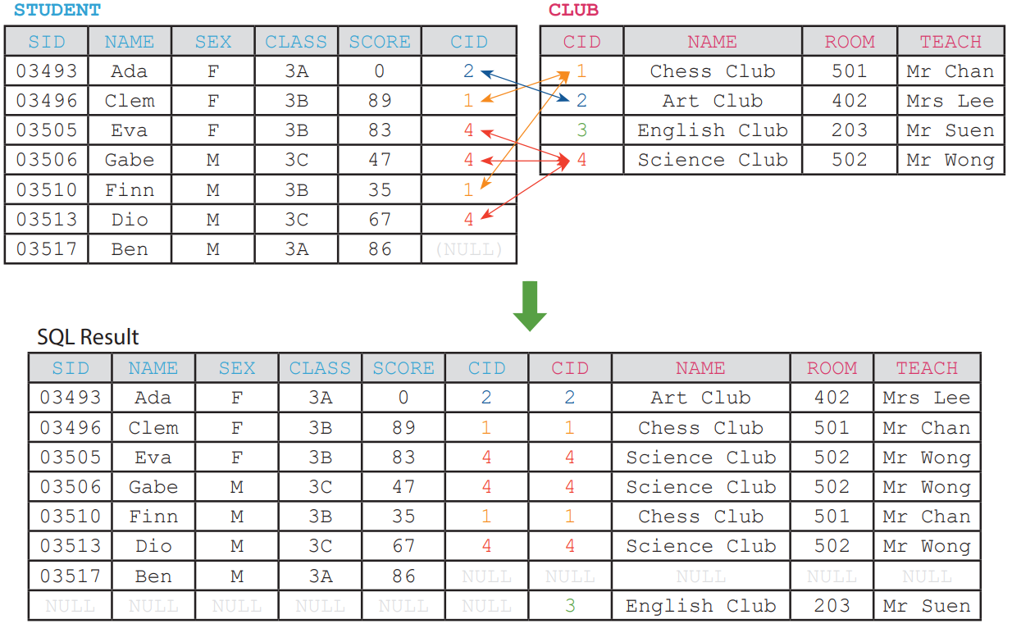
FULL JOIN
D

Slide 20
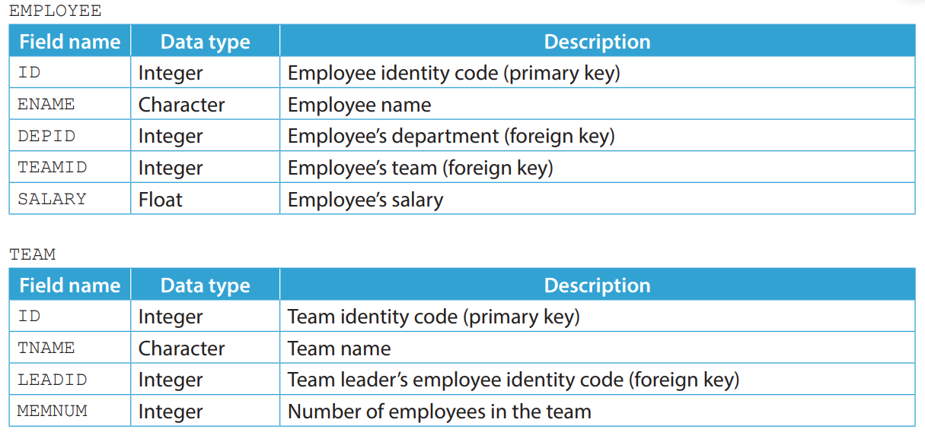
3.1
1. The manager of a company uses three tables, EMPLOYEE, TEAM and DEPARTMENT to manage the employees of the company.

Slide 21
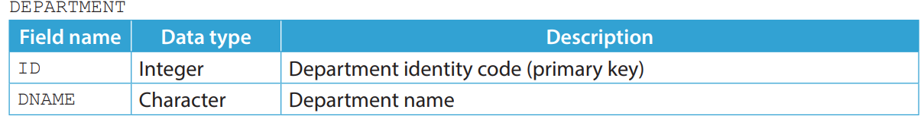
3.1
(a) Write SQL statements to complete the following tasks.
(i) Assume that every employee is part of a department. List the name of each employee with the name of their department. The result should not include departments that have no employee.
(ii) Assume that some teams do not have a team leader assigned. List the name of each team with the name of its team leader (if any).
(iii) Assume that every employee is part of a team. List the name of each employee with the name of their team. The result should include teams that has no employee assigned.

Slide 22
3.1
(b) (i) One of the fields in TEAM may cause data inconsistency when there are new records added
into EMPLOYEE. Which one is it?
(ii) The value to be stored in the field mentioned in (i) can be calculated using a function instead.
Write a SQL statement to retrieve this value using a function. Include the team names in the SQL result.
(c) A manager wants to find every team's average salary, excluding those teams with an average
salary less than 20000. Should they use the following SQL statement?
SELECT TNAME, AVG(SALARY) FROM EMPLOYEE
RIGHT JOIN TEAM ON TEAMID = TEAM.ID
WHERE SALARY >= 20000 GROUP BY TEAM.ID
If not, write a correct SQL statement for them.

Slide 23
3.1
◣ Solution
(a) Note that there are multiple ways to yield the same result.
(i) SELECT ENAME, DNAME FROM EMPLOYEE
LEFT JOIN DEPARTMENT ON DEPID = DEPARTMENT.ID
(ii) SELECT TNAME, ENAME FROM TEAM
LEFT JOIN EMPLOYEE ON LEADID = EMPLOYEE.ID
(iii) SELECT ENAME, TNAME FROM TEAM
LEFT JOIN EMPLOYEE ON TEAM.ID = TEAMID

Slide 24
3.1
(b) (i) MEMNUM
(ii) SELECT TNAME, COUNT(ENAME) FROM EMPLOYEE
RIGHT JOIN ON TEAMID = TEAM.ID GROUP BY TEAM.ID
(c) No.
SELECT TNAME, AVG(SALARY) FROM EMPLOYEE
RIGHT JOIN TEAM ON TEAMID = TEAM.ID
GROUP BY TEAM.ID HAVING AVG(SALARY) >= 20000

Slide 25
3.1
Finish Checkpoint 3.1 on P. 120 of your textbook.
(a)
(i) SELECT SHOP.NAME FROM SHOP INNER JOIN MANR ON SHOP.MID = MANR.MID WHERE MANR.NAME = 'Ada‘
(ii) SELECT PROD.NAME, LOCATION FROM PROD LEFT JOIN SHOP ON PROD.SID = SHOP.SID WHERE PROD.NAME LIKE '%Pen' AND PRICE < 11.5
(iii) SELECT SHOP.NAME, COUNT(PID) FROM SHOP LEFT JOIN PROD ON SHOP.SID = PROD.SID GROUP BY SHOP.SID
(iv) SELECT SHOP.NAME, LOCATION, SUM(STOCK) FROM SHOP LEFT JOIN PROD ON SHOP.SID = PROD.SID WHERE PRICE > 25 GROUP BY SHOP.SID

Slide 26
3.1
(b) To find the highest product price for each product category in each shop.
(c) No.
SELECT s.NAME, AVG(PRICE) FROM SHOP s LEFT JOIN PROD p ON s.SID = p.SID WHERE PRICE < 1000 GROUP BY s.SID

Slide 27
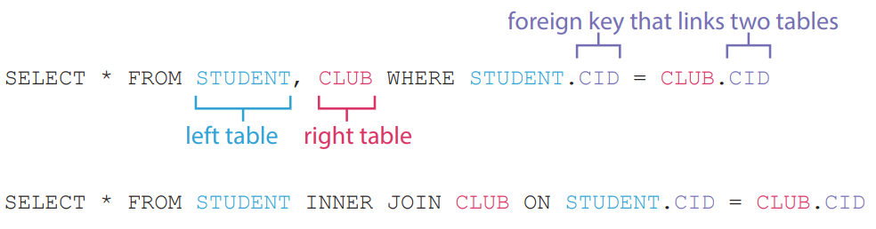
Other joining methods
E
Equi-join is just another way to perform INNER JOIN.
Both SQL statements below yields the same result.

Slide 28
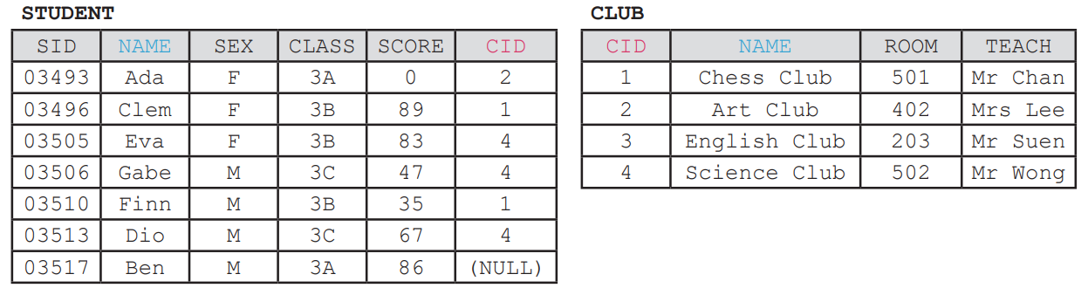
Other joining methods
E
NATURAL JOIN is also the same as INNER JOIN, except that it automatically joins on fields that share the same name in both tables.
These two tables below cannot be joined using NATURAL JOIN, as there are two pair of fields that share the same name: NAME and CID.

Slide 29
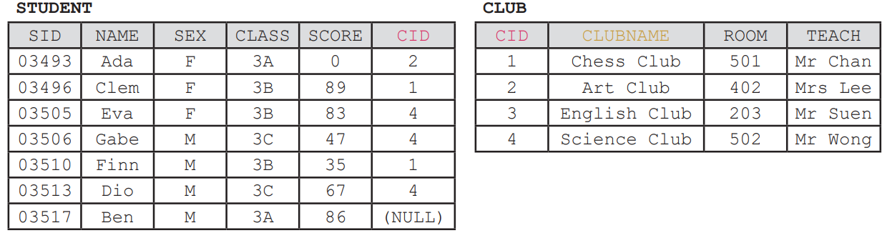
Other joining methods
E
We may rename NAME in CLUB to CLUBNAME and use NATURAL JOIN to join both tables.

Slide 30
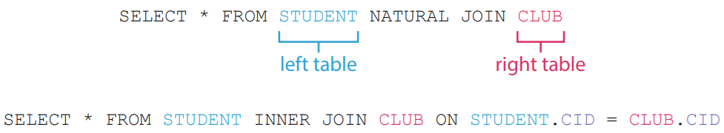
Other joining methods
E
Both SQL statements below yields the same result.

Slide 31
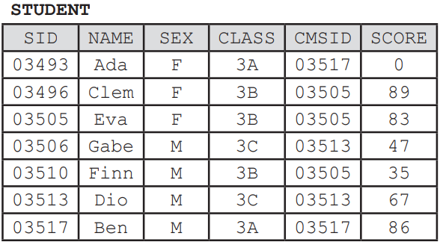
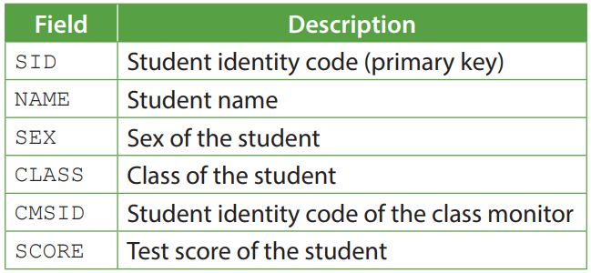
Other joining methods
E
Self join means joining a table to itself. To do so, we have to give a table two different aliases in a SQL statement, so that the DBMS treats it as two different tables temporarily.
See the following table:

Slide 32
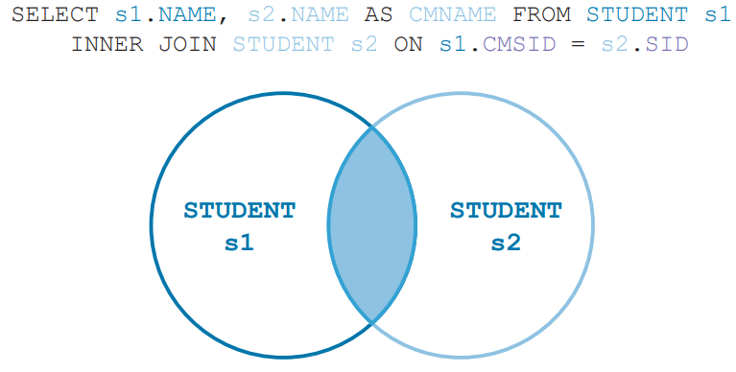
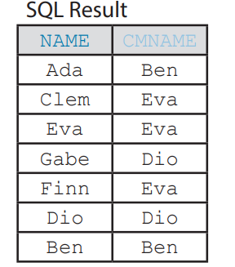
Other joining methods
E
To list every student with the names of their corresponding class monitors, we need to perform a self join on the table STUDENT.

Slide 33
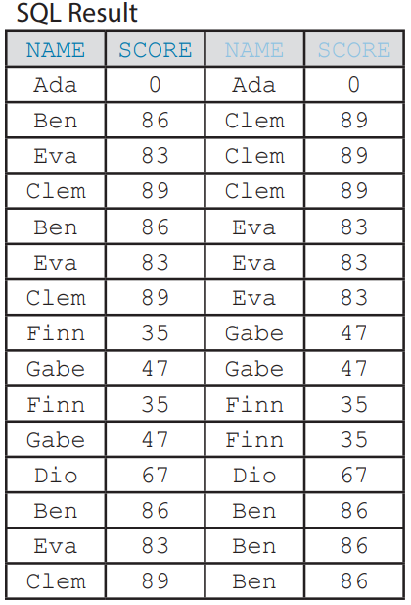
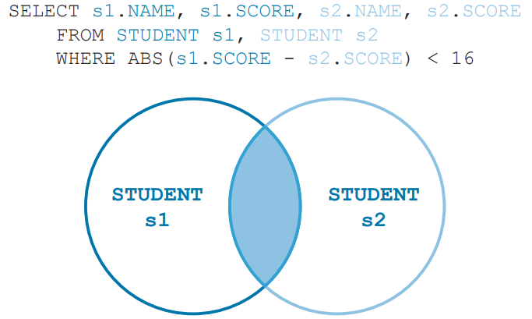
Other joining methods
E
A teacher wants to identify potential study partners with similar academic performance. They may use the following SQL statement to select the names and scores of pairs of students from the table STUDENT where the difference between their test scores is less than 16:

Slide 34
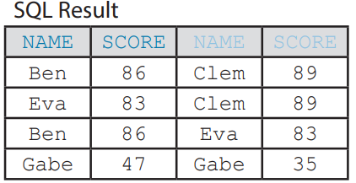
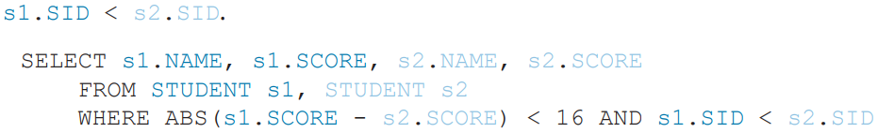
Other joining methods
E
However, this SQL statement:
pairs up a student with themselves, e.g. “Ada & Ada”; and
returns duplicated pairs, e.g. “Ben & Clem” and “Clem & Ben”.
To remove self-pairing and duplicated pairs, we may add the criterion

Slide 35
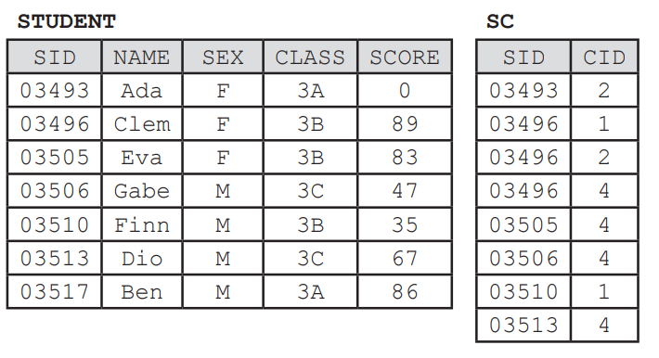
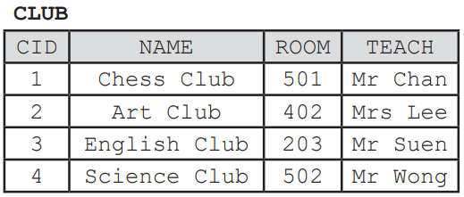
Other joining methods
E
Sometimes, we may need to join more than two tables. Take these three tables as an example.

Slide 36
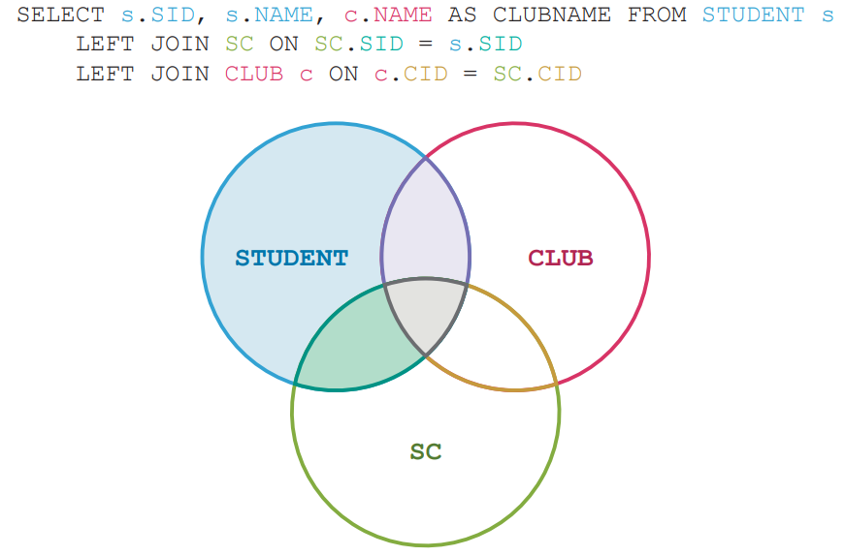
Other joining methods
E

Slide 37
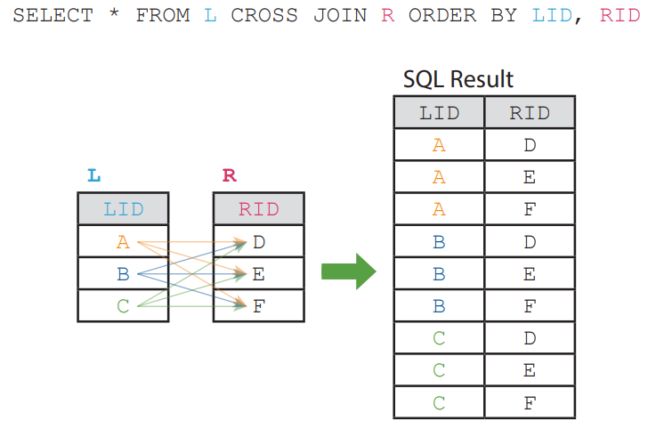
Other joining methods
E
CROSS JOIN does not need a foreign key to join on. It simply matches each row of the left table to each row of the right table. Take the following tables as an example.

Slide 38
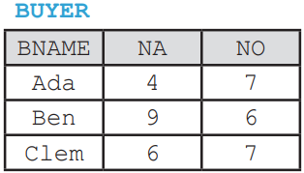
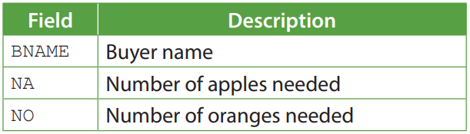
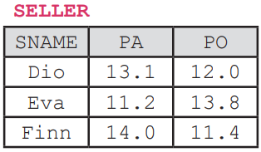
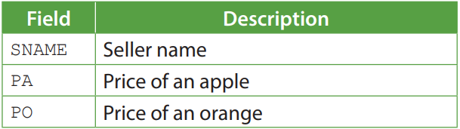
Other joining methods
E
For its practical use, see the following example.

Slide 39
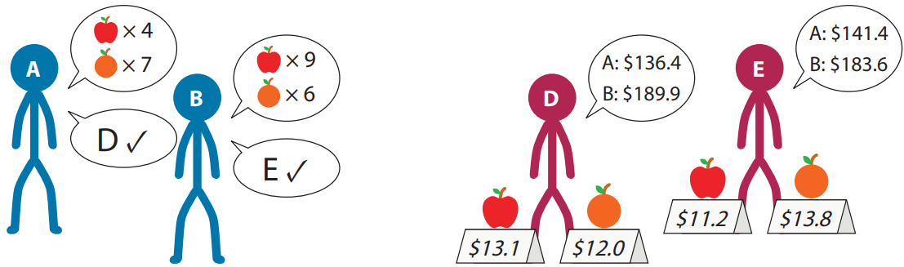
Other joining methods
E
There are buyers who want to buy different numbers of apples and oranges, as well as sellers who sell apples and oranges at different prices.

Slide 40
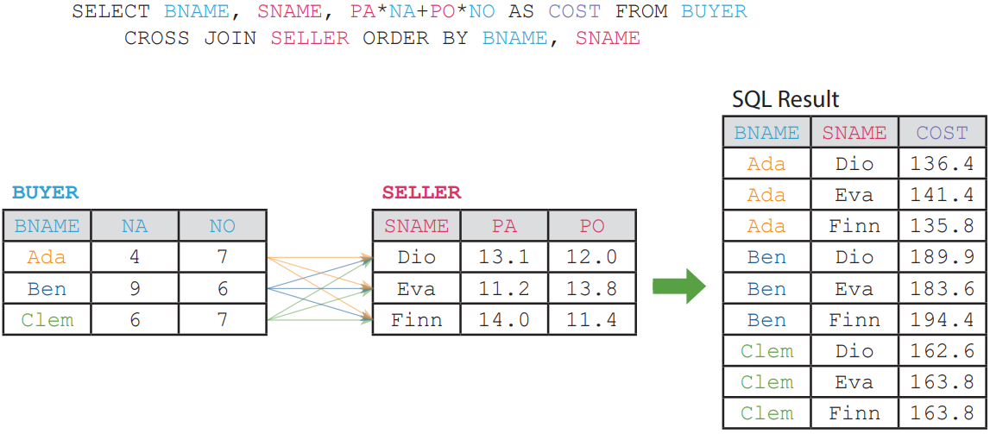
Other joining methods
E
Assume that each buyer wants to buy fruits for the lowest cost. To find out from which seller a particular buyer should buy, we may use the following SQL statement.

Slide 41
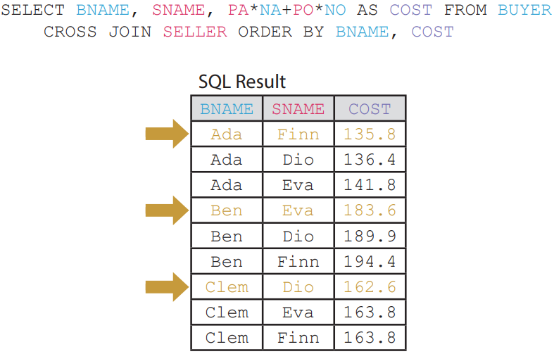
Other joining methods
E
Sort the result to find the desired seller for each buyer easily.

Slide 42
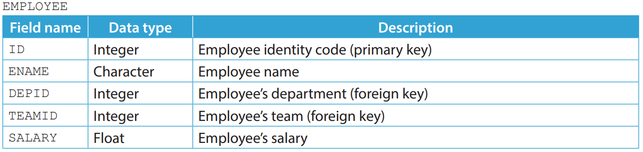
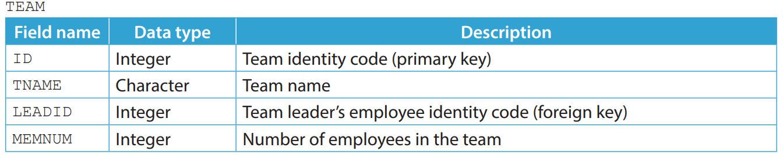
3.2
1. The manager of a company uses three tables, EMPLOYEE, TEAM and DEPARTMENT to manage the employees of the company.

Slide 43
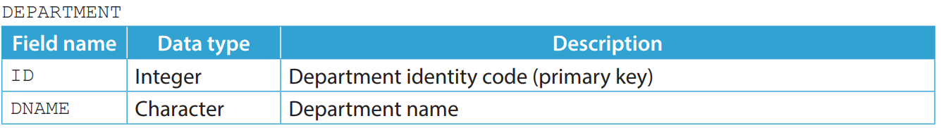
3.2
Assume that every employee is part of a team and every team has at least one employee, while every team is part of a department and every department has at least one team. Write SQL statements to complete the following tasks.
(a) List the name of each employee with the name of their department sorted by the department identity code in ascending order.
(b) List the name of each department with the name and head count of its teams sorted by the team identity code.

Slide 44
3.2
(c) Assume that every team has a team leader. List the name of each employee with the name of their team leader sorted by the employee identity code in ascending order. Give an alias, LNAME to the column of the team leader name.
(d) List the department name and the sum of the salary of the employees in departments whose names start with “IT” sorted by the sum of the salary in descending order.
(e) List the department name, the sex and the average salary of the employees for each sex in each department sorted by the department name and the sex in ascending order.

Slide 45
3.2
◣ Solution
(a) SELECT ENAME, DNAME FROM EMPLOYEE e, TEAM t, DEPARTMENT d WHERE TEAMID = t.ID AND DEPID = d.ID ORDER BY d.ID
(b) SELECT DNAME, TNAME, COUNT(*) FROM DEPARTMENT d, TEAM t, EMPLOYEE e WHERE d.ID = DEPID AND TEAMID = t.ID GROUP BY t.ID ORDER BY t.ID
(c) SELECT e.ENAME, l.ENAME AS LNAME FROM EMPLOYEE e, TEAM t, EMPLOYEE l WHERE e.TEAMID = t.ID AND LEADID = l.ID ORDER BY e.ID

Slide 46
3.2
(d) SELECT DNAME, SUM(SALARY) FROM DEPARTMENT d, TEAM t, EMPLOYEE e WHERE d.ID = DEPID AND TEAMID = t.ID AND DNAME LIKE 'IT%‘ GROUP BY d.ID ORDER BY SUM(SALARY) DESC
(e) SELECT DNAME, SEX, AVG(SALARY) FROM DEPARTMENT d, TEAM t, EMPLOYEE e WHERE d.ID = DEPID AND TEAMID = t.ID GROUP BY d.ID, SEX ORDER BY DNAME, SEX

Slide 47
3.2
Complete Checkpoint 3.2 on P. 133 of your textbook.
(a) SELECT COUNT(PID) FROM PROD p, SHOP s, MANR m WHERE p.SID = s.SID AND s.MID = m.MID AND SEX = 'F'
(b) SELECT MNAME, SUM(STOCK) FROM PROD p, SHOP s, MANR m WHERE p.SID = s.SID AND s.MID = m.MID GROUP BY m.MID ORDER BY MNAME
(c) SELECT DIST, AVG(PRICE) FROM PROD p, SHOP s, MANR m WHERE p.SID = s.SID AND s.MID = m.MID AND MNAME = 'Paul' GROUP BY DIST
(d) SELECT SUM(PRICE) FROM PROD p, SHOP s, MANR m WHERE p.SID = s.SID AND s.MID = m.MID AND STOCK > 100 AND SEX = 'M'

Slide 48
Subquery
3.2
To find the name of the student who gets the highest score, a single function does not suffice. We need a query inside another query, which is called subquery.

Slide 49
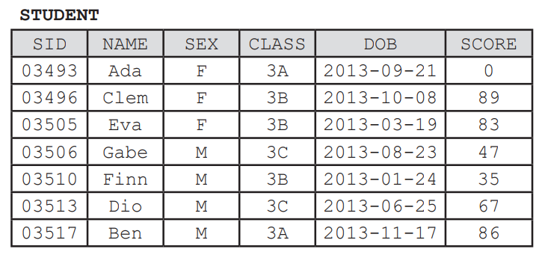
Subquery
3.2
Take this table as an example.

Slide 50
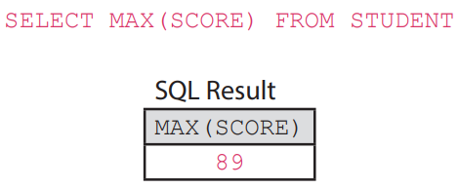
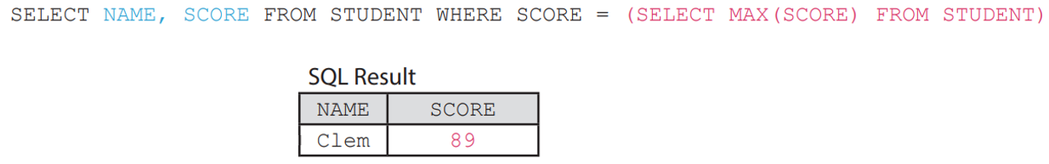
Subquery
3.2
To find the highest score, we may use the following SQL statement.
Substitute SELECT MAX(SCORE) FROM STUDENT for 89 and enclose it with parentheses. We have:

Slide 51
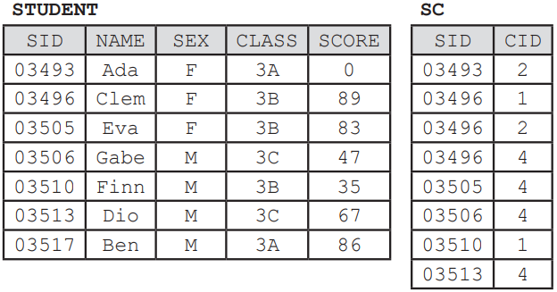
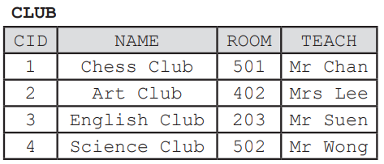
IN
A
IN is a logical operator which checks for the existence of certain values in other tables. Take the three tables below as an example.

Slide 52
IN
A
The following SQL statement finds the names of the students who have joined at least one club and have a score above 70.
The following SQL statement finds the same result with subquery instead of joining tables.

Slide 53
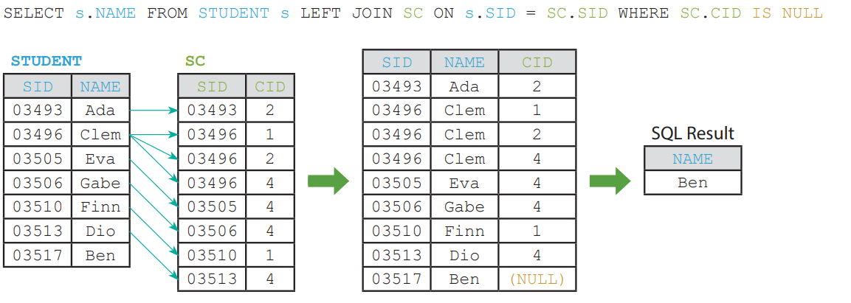
IN
A
On the other hand, we may use NOT IN to check for the absence of certain values in other tables.
The following SQL statement finds the names of the students who have not joined any club.

Slide 54

IN
A
Here is another example of using subquery instead of joining tables.

Slide 55

IN
A
Subquery may help us insert, update and delete data too.
Here is a table named STUDENT2, storing the data of the new students.

Slide 56

IN
A
To insert the data of these students into the table STUDENT, we may use the following SQL statement.
INSERT INTO STUDENT (SELECT ID, NAME, SEX, CLASS, 0 FROM STUDENT2)

Slide 57

IN
A
The following statement updates their score to NULL.
UPDATE STUDENT SET SCORE = NULL WHERE SID IN (SELECT ID FROM STUDENT2)

Slide 58

IN
A
To delete the data of these students from the table STUDENT, we may use the following SQL statement.
DELETE FROM STUDENT WHERE SID IN (SELECT ID FROM STUDENT2)

Slide 59

EXISTS
B
EXISTS is a logical operator which checks for the existence of the result of a subquery. Functionally, EXISTS is similar to IN.
Here is a table named STUDENT2, storing the data of the new students.

Slide 60
EXISTS
B
The following SQL statement finds the names and the scores of the students in STUDENT who have the same score as any of the students in STUDENT2.
SELECT NAME, SCORE FROM STUDENT s WHERE EXISTS (SELECT 1 FROM STUDENT2 s2 WHERE s.SCORE = s2.SCORE)
The whole SQL statement can be rewritten using IN as below:
SELECT NAME, SCORE FROM STUDENT s WHERE SCORE IN (SELECT SCORE FROM STUDENT2 s2)

Slide 61
EXISTS
B
On the other hand, we may use NOT EXISTS to check for the absence of the result of a subquery.
SELECT NAME, SCORE FROM STUDENT s WHERE NOT EXISTS (SELECT 1 FROM STUDENT2 s2 WHERE s.SCORE = s2.SCORE)

Slide 62

ANY
C
ANY is a logical operator which compares a single values with any of the values in a list. It can be written as SOME.
Here is a table named STUDENT2, storing the data of the new students.

Slide 63



ANY
C
The following SQL statement finds the names of the students who is in the same class as any of the new students.
SELECT NAME FROM STUDENT WHERE CLASS = ANY (SELECT CLASS FROM STUDENT2)

Slide 64

ANY
C
IN cannot be rewritten as = ANY since IN can be followed by a list of values while = ANY must be followed by a subquery.

Slide 65


ANY
C
ANY can also be placed after comparison operators other than =.
The following SQL statement finds the names and the scores of the students who get a score higher than some of the new students.
SELECT NAME, SCORE FROM STUDENT WHERE SCORE > ANY (SELECT SCORE FROM STUDENT2)

Slide 66

ALL
D
ALL is a logical operator which compares a single values with all of the values in a list.
Here is a table named STUDENT2, storing the data of the new students.

Slide 67



ALL
D
The following SQL statement finds the names of the students who is not in the same class as all of the new students.
SELECT NAME FROM STUDENT WHERE CLASS <> ALL (SELECT CLASS FROM STUDENT2)

Slide 68



ALL
D
ALL can also be placed after comparison operators other than <>.
The following SQL statement finds the names and the scores of the students who get a score higher than all new students.
SELECT NAME, SCORE FROM STUDENT WHERE SCORE > ALL (SELECT SCORE FROM STUDENT2)

Slide 69

3.3
1. The manager of multiple cat hotels uses three tables, CAT, BREED and HOTEL to manage the cats resided in the hotels.

Slide 70

3.3
Write SQL statements to complete the following tasks.
(a) List the name of each cat breed that currently exists in the hotel named Alpha.
(b) List the name of each cat that resides in the hotel named Beta and weighs more than the global average weight of its breed.
(c) List the name of each hotel with more cats than its capacity.

Slide 71
3.3
(d) List the name of each Ragdoll cats with an age larger than the average age of all Ragdoll cats across all hotels.
(e) List the name of each hotel that do not have any Ragdoll cats resided in.
(f) What is the purpose of the following SQL statement?
SELECT h.NAME, COUNT(DISTINCT c.BID) FROM HOTEL h LEFT JOIN CAT c ON h.ID = c.HID GROUP BY h.ID

Slide 72
3.3
◣ Solution
(a) SELECT NAME FROM BREED WHERE ID IN (SELECT BID FROM CAT, HOTEL h WHERE HID = h.ID AND h.NAME = 'Alpha')
(b) SELECT c.NAME FROM CAT c, BREED b, HOTEL h WHERE BID = b.ID AND HID = h.ID AND h.NAME = 'Beta' AND c.WEIGHT < b.WEIGHT
(c) SELECT NAME FROM HOTEL h WHERE (SELECT COUNT(c.ID) FROM CAT c WHERE HID = h.ID) > CAPACITY

Slide 73
3.3
(d) SELECT c.NAME FROM CAT c, BREED b WHERE BID = b.ID AND b.NAME = 'Ragdoll' AND AGE > (SELECT AVG(c2.AGE) FROM CAT c2 WHERE c2.BID = b.ID)
(e) SELECT NAME FROM HOTEL WHERE ID NOT IN (SELECT HID FROM CAT, BREED b WHERE BID = b.ID AND b.NAME = 'Ragdoll')
(f) It counts the number of breeds within each hotel.

Slide 74
3.3
Complete Checkpoint 3.3 on P. 156 of your textbook.
(a) SELECT COUNT(ID) FROM PLAYER WHERE ID IN (SELECT OWNER FROM ARMY a, CLASS c WHERE CID = c.ID AND STR > 90)
(b) SELECT NAME FROM PLAYER WHERE ID IN (SELECT OWNER FROM ARMY a, CLASS c WHERE CID = c.ID AND HP = MAXHP)
(c) SELECT NAME FROM PLAYER WHERE GOLD >= (SELECT SUM(COST) FROM CLASS WHERE NAME LIKE '%mage') ORDER BY ID

Slide 75
3.3
(d) SELECT NAME, COUNT(a.ID) FROM PLAYER p LEFT JOIN ARMY a ON OWNER = p.ID WHERE LEVEL > (SELECT AVG(LEVEL) FROM PLAYER) GROUP BY p.ID ORDER BY LEVEL DESC
(e) SELECT p1.NAME, p1.LEVEL, p2.NAME, p2.LEVEL FROM PLAYER p1, PLAYER p2 WHERE ABS(p1.LEVEL - p2.LEVEL) <= 5 AND p1.ID < p2.ID
(f) It lists the name of each player who has no army. SELECT NAME FROM PLAYER WHERE ID NOT IN (SELECT OWNER FROM ARMY)

Slide 76

Combining Results
3.3
Sometimes we want to combine the results from two queries.
For example, we have two tables storing the data of students: STUDENT and STUDENT2.

Slide 77


UNION
A
If we want to show the identity codes of students from both tables at the same time, we may use the set operator UNION.
The following SQL statement lists the identity codes of students from both tables. Duplicated rows are removed, as if DISTINCT is used.

Slide 78

UNION
A
Note that only rows with completely identical data will be removed. Thus, if we also select NAME from the tables, both rows with identity codes of 03517 will be shown.
SELECT SID, NAME FROM STUDENT UNION SELECT STUDENTID, NAME FROM STUDENT2

Slide 79
UNION
A
It does not matter if the field names from both results match, as long as the number of fields in both results match, we can combine them using UNION.
However, if both results store different kinds of data, the combined result may not be meaningful.
SELECT DOB FROM STUDENT2 UNION SELECT STUDENTID FROM STUDENT2

Slide 80

UNION
A
The result can be filtered, sorted or summarised using keywords like WHERE just as usual.
SELECT SID FROM STUDENT UNION SELECT STUDENTID FROM STUDENT2 WHERE CLASS = '3B'

Slide 81

UNION
A
If we want to filter the data of STUDENT, we have to add a WHERE clause after SELECT SID FROM STUDENT. An ORDER BY clause, on the other hand, should be applied to the whole combined result instead.

Slide 82

UNION
A
Field names from the second result (i.e. STUDENT2) are not carried to the combined result, we should use the field names from the first result (i.e. STUDENT) in the ORDER BY clause.

Slide 83

UNION ALL
B
The following SQL statement lists the identity codes of students from both tables. Duplicated rows are NOT removed.

Slide 84


INTERSECT
C
The following SQL statement lists the identity codes of students which exist in both tables.

Slide 85


EXCEPT
D
EXCEPT returns the rows from the first table excluding those which also exist in the second table. Sometimes, it is written as MINUS.
The following SQL statement lists the identity codes of students which exist in STUDENT but not in STUDENT2.

Slide 86


EXCEPT
D
We may also include more than one set operator in a SQL statement.
SELECT SID FROM S1 INTERSECT SELECT SID FROM S2 INTERSECT SELECT SID FROM S3

Slide 87

3.4
1. A sports meeting is coming up. There are two sport events, a football game and a relay race. The organiser of this meeting uses three tables, PARTICIPANT, FOOTBALL and RELAYRACE to manage the data of the contestants in two sport events.

Slide 88

3.4
Given that there are participants who have not decided which sport event to participate in, write SQL statements to complete the following tasks.
(a) List the occurrence of every bib number in both sport events. If a bib number appears twice, list it twice in the result, so on and so forth. Sort the numbers in ascending order.
(b) List the participant identity code of each participant who belongs to the team named “A” in at least one of the sport events.

Slide 89
3.4
(c) List the name of each female participant who participates in the football game but not in the relay race.
(d) List the name of each participant who is at least 22 years old and does not participate in both sport events at the same time.

Slide 90
3.4
◣ Solution
(a) SELECT BIB FROM FOOTBALL UNION ALL SELECT BIB FROM RELAYRACE ORDER BY BIB This SQL statement below is wrong and cannot be executed. SELECT BIB FROM FOOTBALL ORDER BY BIB UNION ALL SELECT BIB FROM RELAYRACE ORDER BY BIB ORDER BY clause cannot be placed in the middle of a SQL statement.

Slide 91
3.4
(b) SELECT PID FROM FOOTBALL WHERE TEAM = 'A‘ UNION SELECT PID FROM RELAYRACE WHERE TEAM = 'A‘ This SQL statement below is wrong and cannot be executed. (SELECT PID FROM FOOTBALL UNION SELECT PID FROM RELAYRACE) WHERE TEAM = 'A‘ WHERE clause cannot be shared between two SELECT clauses.

Slide 92
3.4
(c) SELECT NAME FROM PARTICIPANT WHERE GENDER = 'F' AND ID IN (SELECT PID FROM FOOTBALL EXCEPT SELECT PID FROM RELAYRACE)
(d) SELECT NAME FROM PARTICIPANT WHERE AGE >= 22 AND ID NOT IN (SELECT PID FROM FOOTBALL INTERSECT SELECT PID FROM RELAYRACE)

Slide 93
3.4
Complete Checkpoint 3.4 on P. 168 of your textbook.
(a) SELECT ISBN FROM WBS WHERE PRICE < 100 EXCEPT SELECT ISBN FROM HBS
(b) SELECT BNAME, AUTHOR FROM BOOK WHERE ISBN IN (SELECT ISBN FROM HBS INTERSECT SELECT ISBN FROM WBS)
(c) SELECT BNAME, PRICE FROM HBS h, BOOK b WHERE h.ISBN = b.ISBN AND PAGE >= 300 UNION SELECT BNAME, PRICE FROM WBS w, BOOK b WHERE w.ISBN = b.ISBN AND PAGE >= 300 ORDER BY BNAME

Slide 94
3.4
(d) SELECT ISBN FROM HBS WHERE ISBN NOT IN (SELECT ISBN FROM BOOK) UNION SELECT ISBN FROM WBS WHERE ISBN NOT IN (SELECT ISBN FROM BOOK) Alternative: SELECT ISBN FROM HBS UNION SELECT ISBN FROM WBS EXCEPT SELECT ISBN FROM BOOK

Slide 95
Creating Views and Indices
3.4
In programming, when we expect a certain part of code to be reused frequently in a program, we create a sub-program to simplify the program.
Similarly, in database, when we expect a certain result of a SQL statement to be reused frequently in summarisation or as subquery, we create a view, which works as a virtual table, to simplify any future SQL statements.

Slide 96




View
A
Consider the following tables:

Slide 97
View
A
Given that the final score of a student is calculated by the formula below:
Final score = first test score × 0.4 + second test score × 0.6
We need a complex SQL statement for each of the following tasks:
1. List the name of each student taught by Mr Suen and has a final score below 60;
2. List the name of each student who joins at least two clubs and has a final score above 60;
3. List the name of each student who is in a class whose teaching language is Chinese and does not join any other clubs besides English Club; and
4. List the name of each student who joins the most number of clubs.

Slide 98
View
A
1. List the name of each student taught by Mr Suen and has a final score below 60. We have to join STUDENT with CLASS to see if a student is taught by Mr Suen.
SELECT NAME FROM STUDENT s, CLASS cl WHERE s.CLASS = cl.CLASS AND
TEACH = 'Mr Suen' AND SCORE1 * 0.4 + SCORE2 * 0.6 < 60

Slide 99
VIEW
A
2. List the name of each student who joins at least two clubs and has a final score above 60. We have to count the number of clubs joined by each student in a subquery.
SELECT NAME FROM STUDENT WHERE SCORE1 * 0.4 + SCORE2 * 0.6 > 60 AND SID IN (SELECT SID FROM SC GROUP BY SID HAVING COUNT(*) >= 2)

Slide 100
VIEW
A
3. List the name of each student who is in a class whose teaching language is Chinese and does not join any other clubs besides English Club.
We have to join STUDENT with CLASS and count the number of clubs joined by each student at the same time.

Slide 101

VIEW
A
4. List the name of each student who joins the most number of clubs.
Without a view, we either treat a result as a table by giving it an alias, or use the keyword LIMIT.

Slide 102

VIEW
A
By using views, all the above statements can be simplified. The following SQL statement creates a view named SCORESHEET.
CREATE VIEW SCORESHEET AS SELECT s.SID, NAME, SEX, s.CLASS, TEACH, LANG, SCORE1*0.4+SCORE2*0.6 AS FSCORE FROM STUDENT s, CLASS cl WHERE s.CLASS = cl.CLASS

Slide 103


VIEW
A
1. List the name of each student taught by Mr Suen and has a final score below 60.

Slide 104

VIEW
A
2. List the name of each student who joins at least two clubs and has a final score above 60.
Now we need a view showing the number of clubs joined by each student.
CREATE VIEW COUNTCLUB AS SELECT SID, COUNT(*) AS CLUBNUM FROM SC GROUP BY SID

Slide 105

VIEW
A
2. List the name of each student who joins at least two clubs and has a final score above 60.

Slide 106



VIEW
A
However, the student Dio with an SID of 03513 joins no club. Thus his SID is not even in the view.

Slide 107

VIEW
A
This may cause problems if we are asked to list the name of each student who joins no more than two clubs instead of at least two clubs.

Slide 108

VIEW
A
Thus, we may use LEFT JOIN or RIGHT JOIN to ensure that the view shows all students.
To modify an existing view, use CREATE VIEW OR REPLACE VIEW.
CREATE OR REPLACE VIEW COUNTCLUB AS SELECT s.SID, COUNT(CID) AS CLUBNUM FROM SC RIGHT JOIN STUDENT s ON SC.sid = s.SID GROUP BY SID

Slide 109

VIEW
A
To further simplify the SQL statement, we may even create a view using another view.
CREATE OR REPLACE VIEW SCORESHEET AS SELECT s.SID, NAME, SEX, s.CLASS, TEACH, LANG, SCORE1*0.4+SCORE2*0.6 AS FSCORE, CLUBNUM FROM STUDENT s, CLASS cl, COUNTCLUB cc WHERE s.CLASS = cl.CLASS AND s.SID = cc.SID

Slide 110

VIEW
A
2. List the name of each student who joins at least two clubs and has a final score above 60.

Slide 111

VIEW
A
3. List the name of each student who is in a class whose teaching language is Chinese and does not join any other clubs besides English Club.

Slide 112

VIEW
A

Slide 113

VIEW
A
4. List the name of each student who joins the most number of clubs.

Slide 114

VIEW
A

Slide 115

VIEW
A
If we do not need a view anymore, we may delete a view using DROP VIEW.
DROP VIEW COUNTCLUB
However, if a deleted view A is referenced in another view B, view B will no longer work after the deletion.

Slide 116

Index
B
When a teacher wants to search by the name of a student, the DBMS needs to go through the table row by row.
In the worst case, if the teacher wants to find a student named Guy, it needs to go through 11 records, i.e. the whole table, to find the required record.

Slide 117

Index
B
Since the name of a student, i.e. NAME, is expected to be searched frequently, we can index that field to speed up the data retrieval process.
Indexing NAME creates an index table containing the indexed field and a pointer to the related records only.

Slide 118

Index
B
The data in the indexed field of the index table is sorted in alphabetic order (or ascending order if it is a number field). The sorting allows the DBMS to perform binary search.
The record in the middle, i.e. the 6th one, Finn is checked. It starts with an F, which is before G as in Guy. Therefore, every record before the 6th one cannot be our guy.

Slide 119

Index
B
The record in the middle of the rest, i.e. the 9th one, Hans is checked. It starts with an H, which is after G as in Guy. Therefore, every record after the 9th one cannot be our guy.

Slide 120

Index
B
The record in the middle of the rest, i.e. the 7th one, Gabe is checked. It starts with an Ga, which is before Gu as in Guy. Therefore, every record before the 7th one cannot be our guy (though every single one of them is already eliminated).

Slide 121

Index
B
The record in the middle of the rest, i.e. the 8th one, Guy is checked. To our surprise, this is the guy

Slide 122
Index
B
As shown in the previous example, we can see how indexing speeds up the data retrieval process.
In the worst case, the DBMS only needs to go through 4 records, instead of 11 records, i.e. the whole table, to find the required record.
However, the index table needs to be updated when:
the data in the indexed field changes (e.g. the name of the student Guy is changed to Gal); or
a new record is added (e.g. a new student named Hope is added).

Slide 123

Index
B
Since the names Gal and Hope is not in the index table, it fails to search for them if it is not updated.

Slide 124

Index
B
To index a field of a table, we may use the keyword CREATE INDEX.
Normally, the name of the index is used only when we have to drop the index.

Slide 125

Index
B
To drop an index, we may use the following SQL statement.
If we forget the name of the index, we may find it out by using SHOW CREATE TABLE.

Slide 126

3.5
1. The manager of a hospital uses two tables, PATIENT and ROOM to manage the data of the patients.

Slide 127
3.5
Write SQL statements to complete the following tasks. (a) Create a view to show the name and capacity of each room, as well as its number of patients. Assume that not every room has patients.
(b) By using the view created in (a), list the name of each room with fewer patients than its capacity.
(c) By using the view created in (a), list the average number of patients in a room. Exclude the room named B01 in the calculation.

Slide 128

3.5
(d) Create a view to show the patient identity code, name, sex, Body Mass Index (BMI) and room name of every patient. Assume that some patients has no room assigned.
The formula of BMI is:
(e) By using the view created in (d), list the lowest BMI of the patients for each sex.
(f) By using the view created in (d), list the highest BMI of the patients for each room. Assume that every room has a unique name. Sort the result by the room name.

Slide 129
3.5
◣ Solution
(a) CREATE VIEW RPNUM AS SELECT r.ID, RNAME, CAPACITY, COUNT(p.ID) AS PNUM FROM ROOM r LEFT JOIN PATIENT p ON r.ID = RID GROUP BY r.ID
(b) SELECT RNAME FROM RPNUM WHERE PNUM < CAPACITY
(c) SELECT AVG(PNUM) FROM RPNUM WHERE RNAME <> 'B01'

Slide 130
3.5
(d) CREATE VIEW PBMI AS SELECT p.ID, PNAME, SEX, WEIGHT/HEIGHT/HEIGHT AS BMI, RNAME FROM PATIENT p LEFT JOIN ROOM r ON RID = r.ID
(e) SELECT SEX, MIN(BMI) FROM PBMI GROUP BY SEX
(f) SELECT RNAME, MAX(BMI) FROM PBMI GROUP BY RNAME ORDER BY RNAME

Slide 131
3.5
Finish Checkpoint 3.5 on P. 188 of your textbook.
(a) CREATE VIEW FORDER2 AS SELECT CID, f.MID, MNAME, OPRICE*(1-DISCOUNT)*NUM AS TPRICE, ETA FROM FORDER f, MEAL m WHERE f.MID = m.MID
(b) SELECT MNAME, SUM(TPRICE) FROM FORDER2 WHERE ETA < '2025-01-25' GROUP BY MID
(c) CREATE OR REPLACE VIEW FORDER2 AS SELECT CID, OPRICE*(1-DISCOUNT)*NUM AS TPRICE, ETA FROM FORDER f, MEAL m WHERE f.MID = m.MID and PAID = FALSE

Slide 132
3.5
(d) CREATE VIEW CPAYMENT AS SELECT CNAME, SEX, DEPOSIT, SUM(TPRICE) AS DUE FROM CUSTOMER c LEFT JOIN FORDER2 f ON c.CID = f.CID GROUP BY c.CID
(e) SELECT SEX, SUM(DUE) FROM CPAYMENT GROUP BY SEX
(f) SELECT CNAME FROM CPAYMENT WHERE DEPOSIT < DUE

